Slide 1

Adidas Sales Analysis
Created By :
Kuldeep Singh Shekhawat
This Photo by Unknown Author is licensed under CC BY-NC

Slide 2
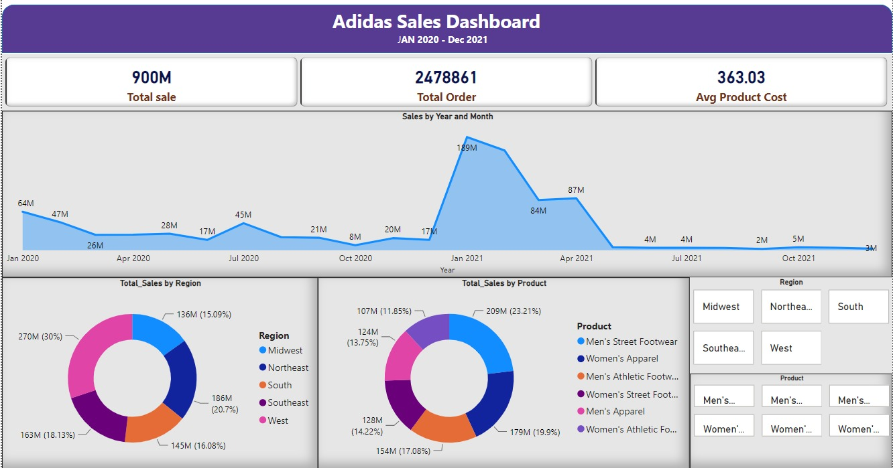
Dashboard No 1

Slide 3
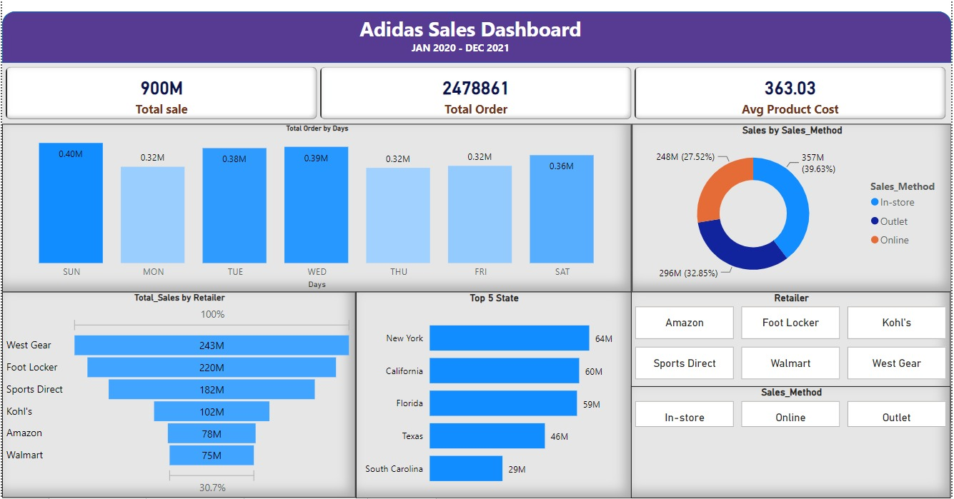
Dashboard No 2

Slide 4
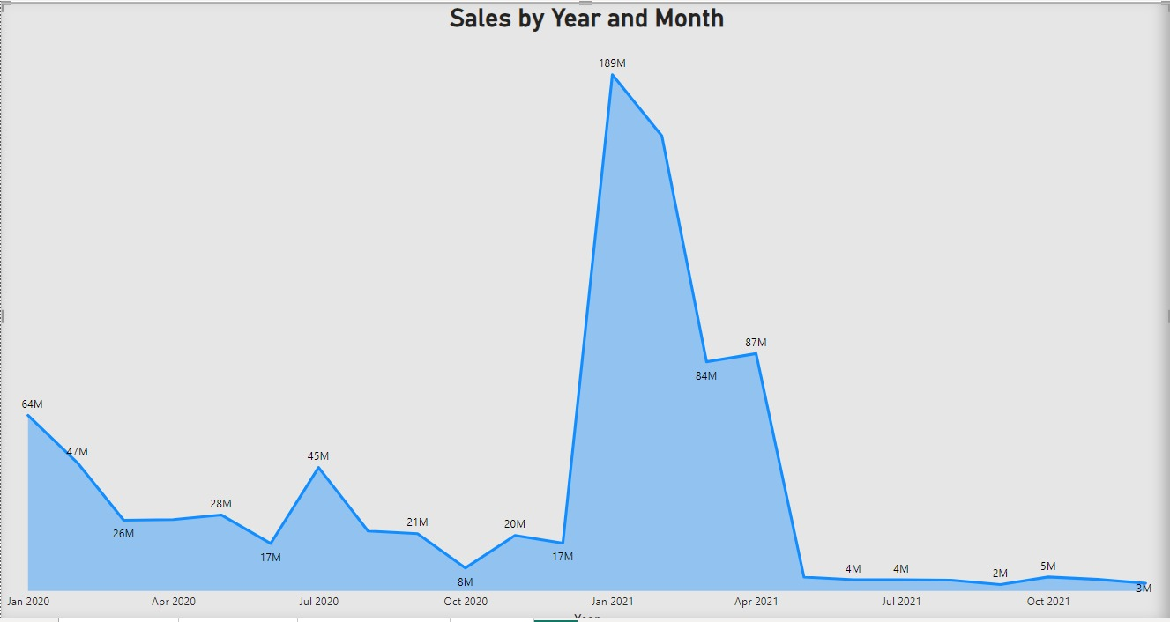
Jan 2020-Dec 2021 Sales
In the chart sales went up from 17 million in December 2020 to 189 million in January 2021. But after May 2021, they fell from 87 million to 4 million

Slide 5
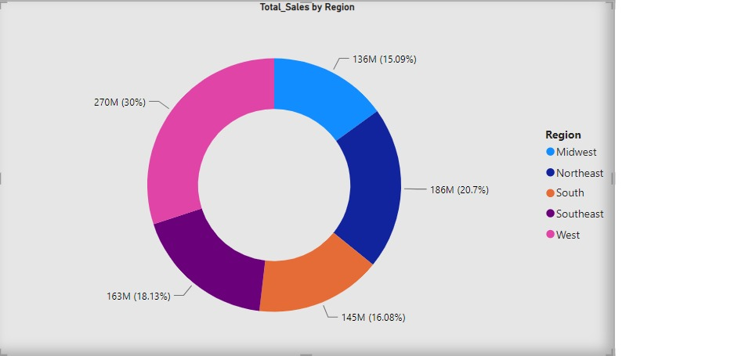
Total Sales By Region
As seen in the donut chart, the Midwest cover 30% of the total sales, while the Northeast covers 20.7%

Slide 6
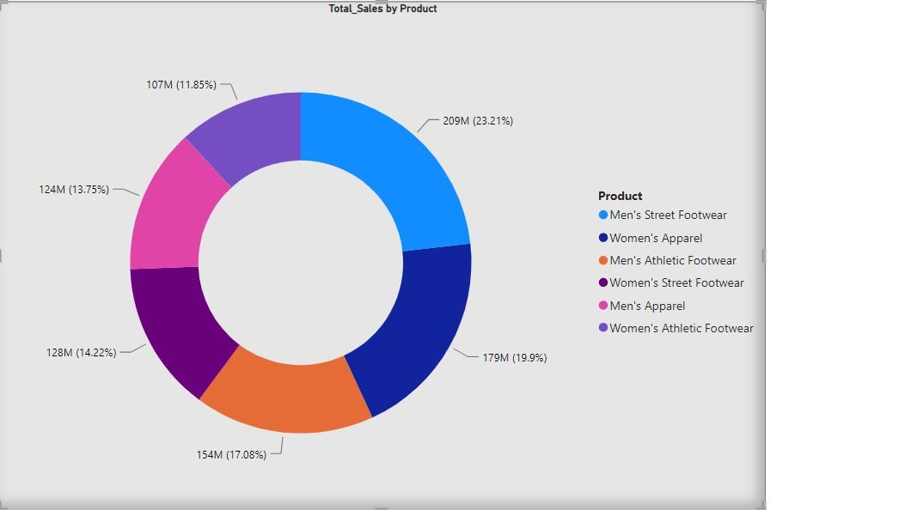
Total Sales by Product
As seen in the donut chart, Men's street footwear comprises the majority of sales at 23.21%, totaling 209 million, while Women's athletics footwear represents the smallest share at 11.85%, equivalent to 107 million

Slide 7
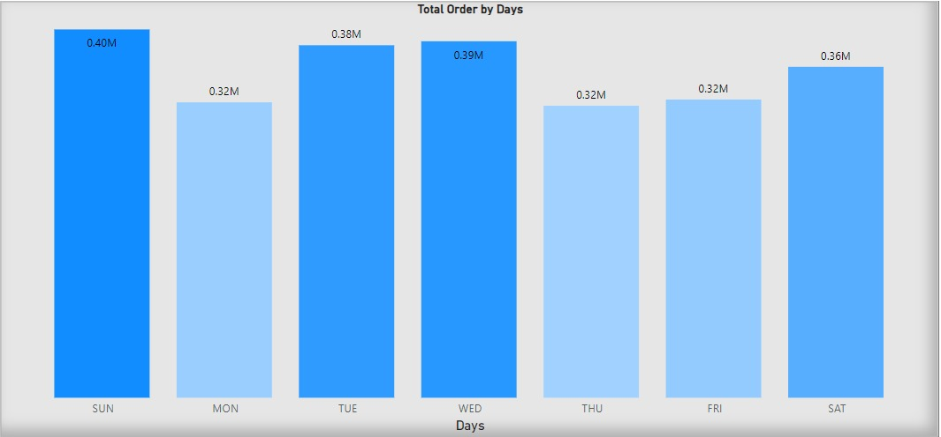
The total orders come in during the week
most of the orders come in on Sunday, Wednesday, and Tuesday

Slide 8
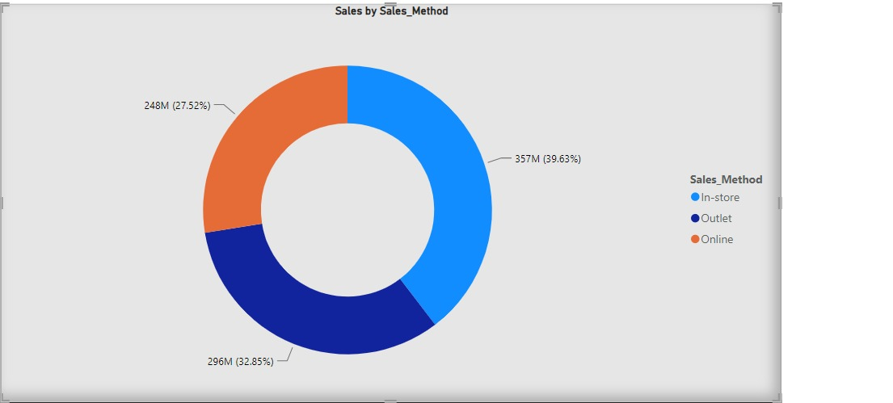
Sales are generated through various sales methods
Most of the sales come through the store, accounting for 39.63%, which is equivalent to 357 million

Slide 9
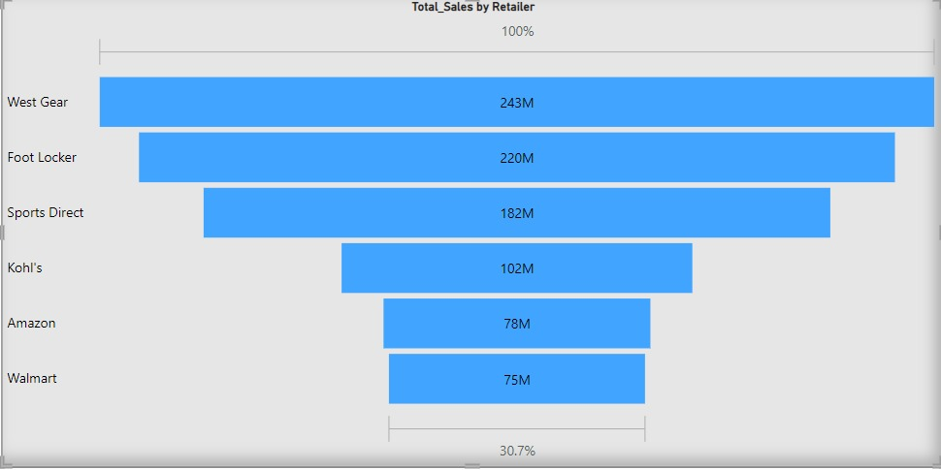
Total sales come through retailers
West Gear contributes the most to sales, totaling 243 million, while Walmart contributes the least, with sales amounting to 75 million

Slide 10
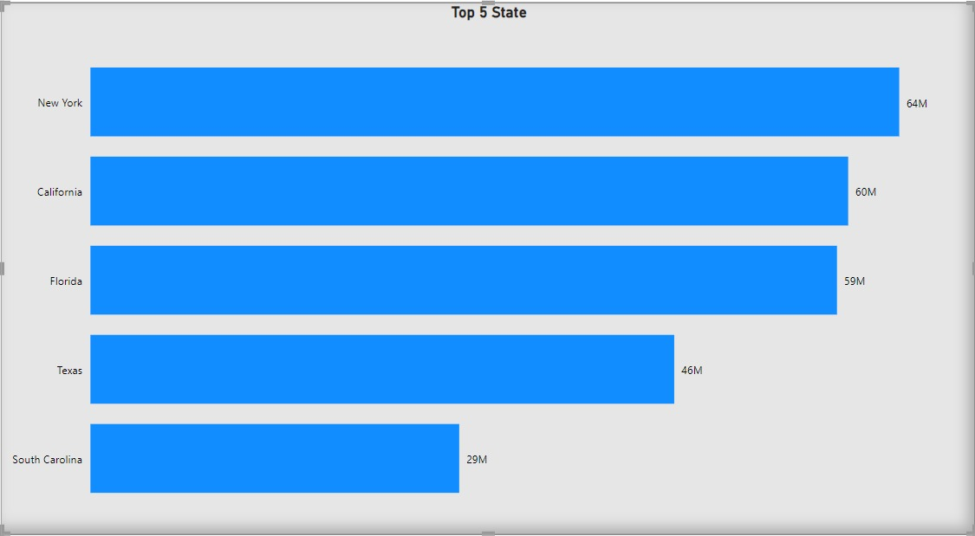
Top 5 State
The top 5 states that contribute the most to sales In all states, New York contributes the most, with sales totaling 64 million

Slide 11
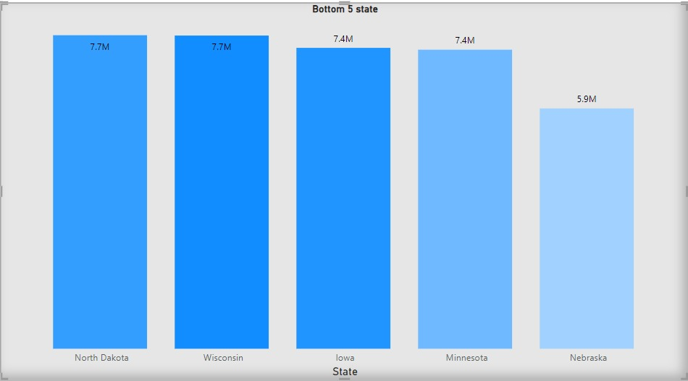
Bottom 5 State
The bottom 5 states that contribute the least to sales In all states, Nebraska contributes the least, with sales totaling 5.9 million

Slide 12

This Photo by Unknown Author is licensed under CC BY-NC

